Slide 1
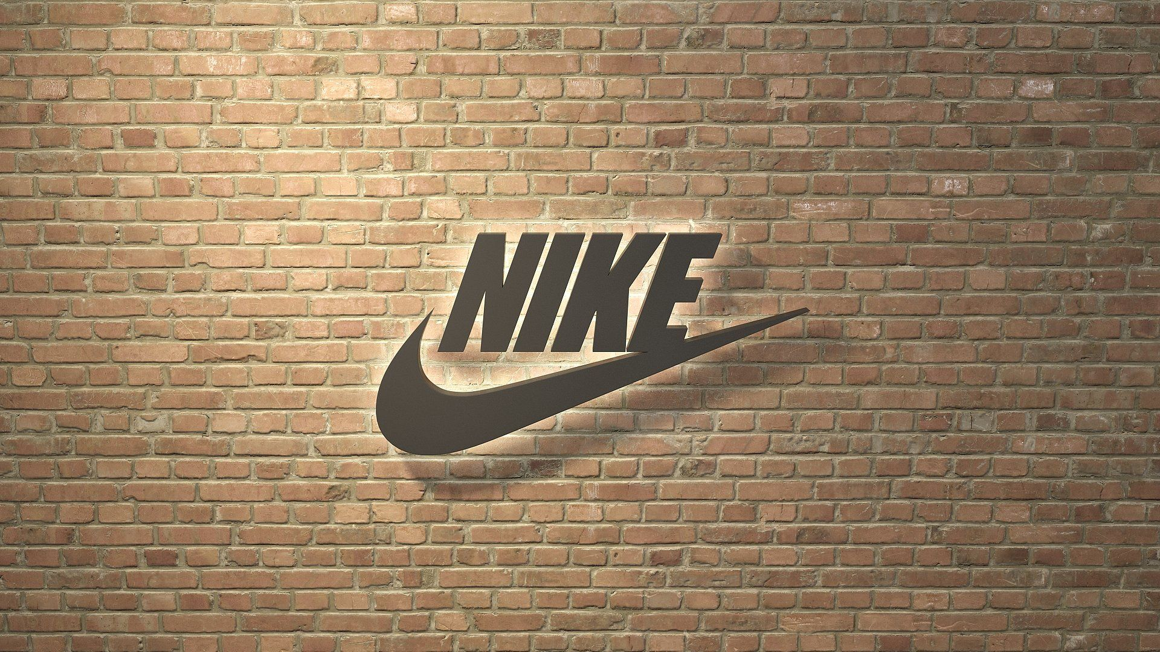
Group 6
Auchal Azad, Shandy Zhen Fung, Jingyu Ge, Ronas Khanal,
Chen Liu, Liza Muzashvili, Estefania Rodas, Seok-hyun Whang

Slide 2
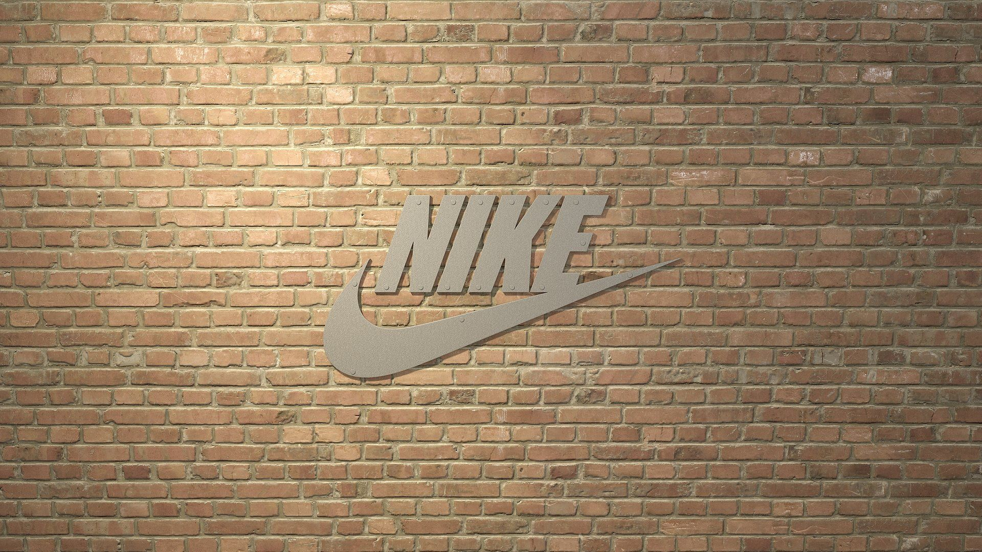
OVERVIEW
Established in 1964 (Blue Ribbon Sports)
Mission
“To bring inspiration and innovation to every athlete in the world.”

Slide 3
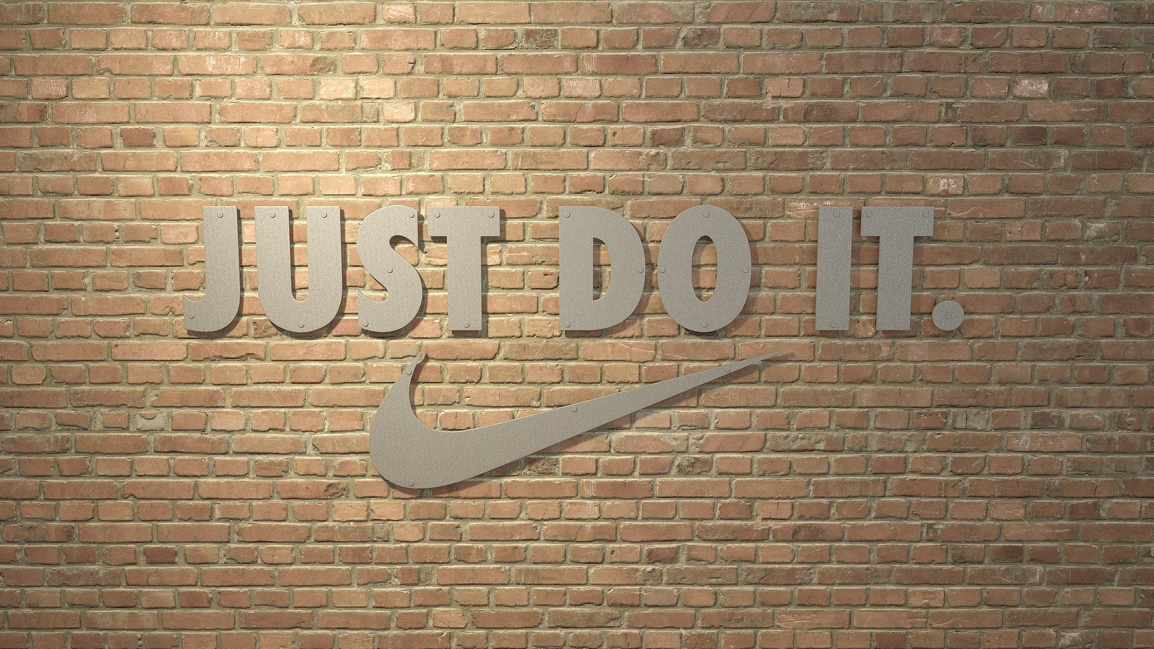
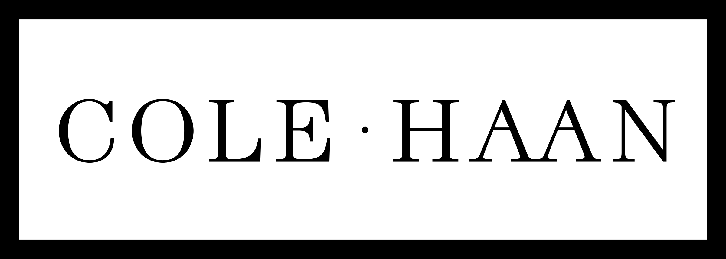
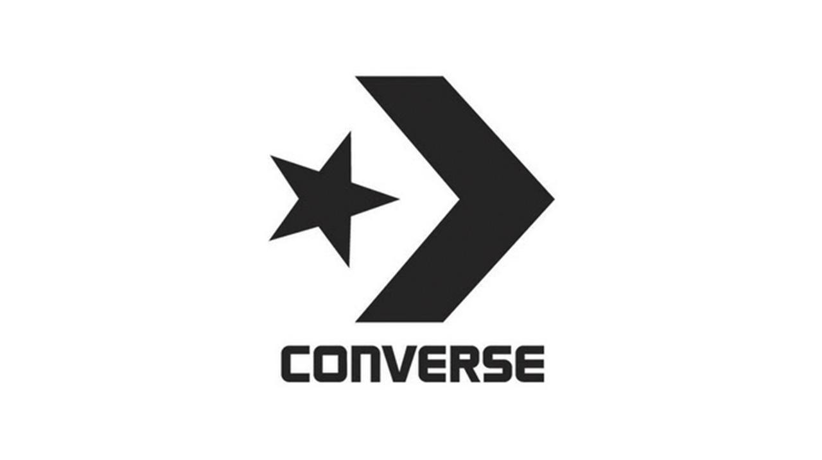
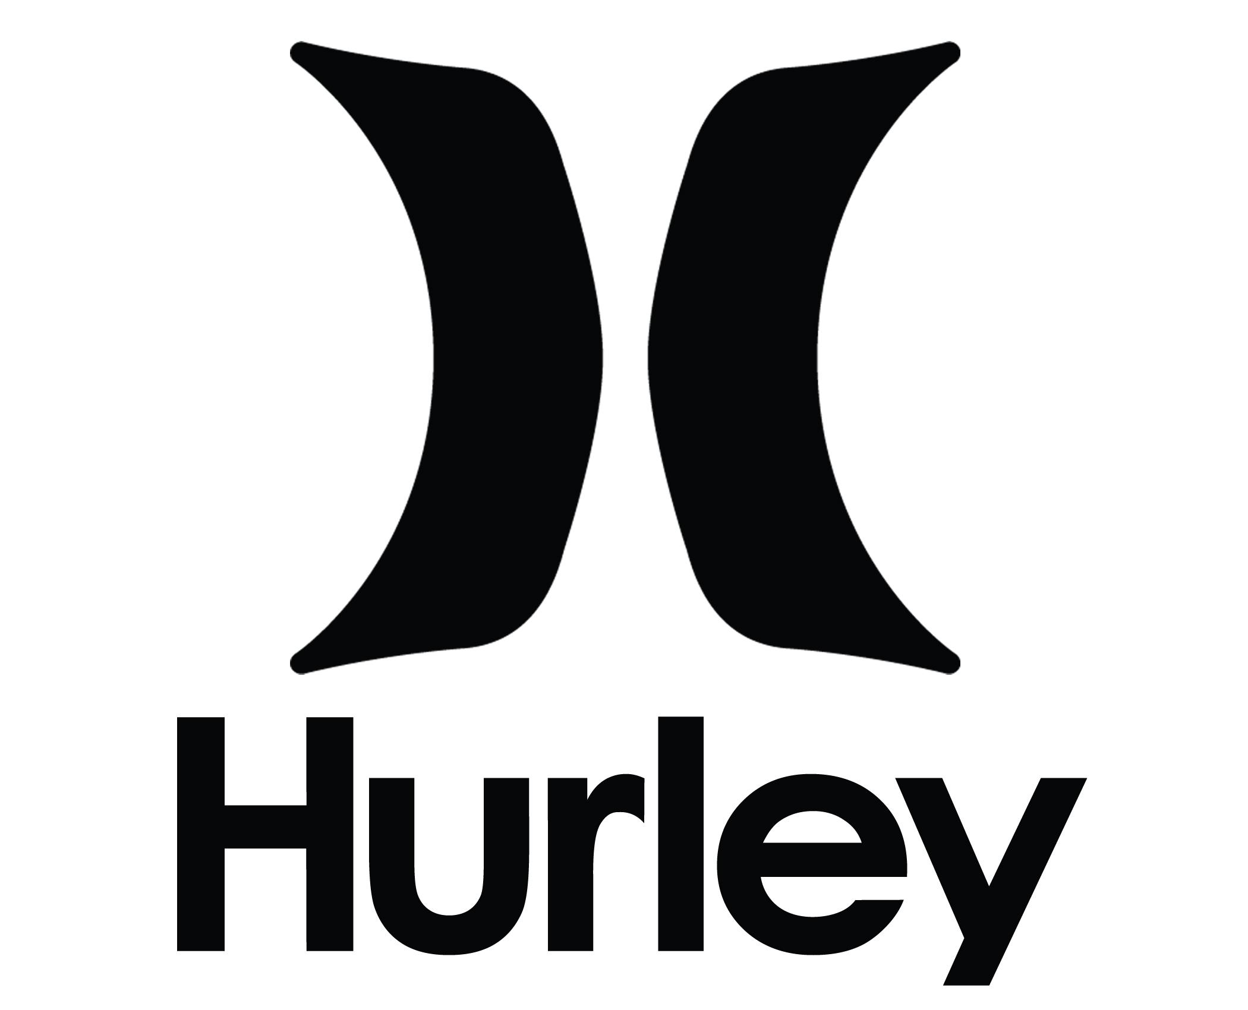
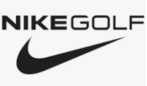
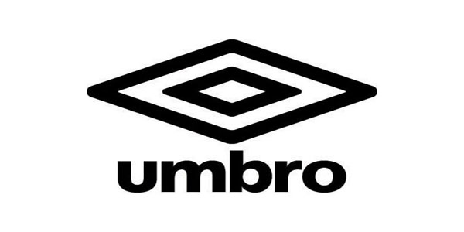
SEGMENT ANALYSIS
Brand Equity
“Just Do It”
Subsidiaries
Cole Haan, Converse, Hurley, Nike Golf, Umbro
Tailor-made products

Slide 4
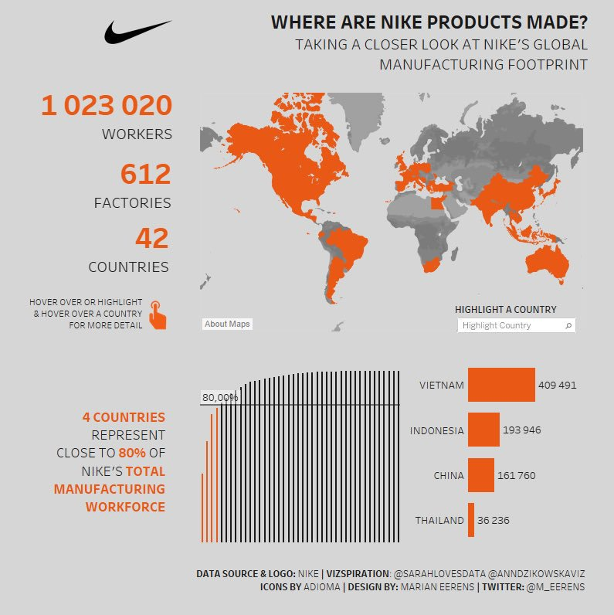
SUPPLY CHAIN MANAGEMENT
Manufacturer
Headquarter
Only focus on core business,
outsourcing production.
Outsourcing
Cheap labor abroad.

Slide 5
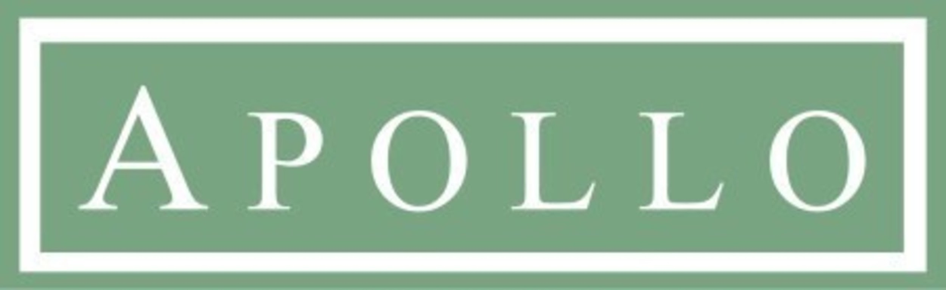
SUPPLY CHAIN MANAGEMENT
Distributor
BOTTLENECK in the manufacturing segment of the supply chain.
Solution
Nike collaborated with Apollo Global Management LLC. to increase revenue and alleviate their bottleneck.

Slide 6
SUPPLY CHAIN MANAGEMENT
Retailer
Local Retail and Clearance store
Official Website
Third-party licenses
Reverse Logistics
Learn from the past
Find out the reason for common errors
Search for the solution and reduce risk

Slide 7
QUALITY MANAGEMENT
Nike is dedicated to the production of innovative and high quality products. Its products satisfy the needs and demands of people all around the world.
The quality characteristics of products/services can be defined in terms of their functionality, appearance, reliability, durability, recovery and contact.
Their focus is to produce and deliver the products and services required by the market demand, both short and long term.
https://purpose.nike.com/sourcing-manufacturing-standards
Notes:
Nike is dedicated to the production of innovative and high quality products. Its products satisfy the needs and demands of people all around the world. Nike acknowledges that the quality characteristics of products/services can be defined in terms of their functionality, appearance, reliability, durability, recovery and contact. Their focus is to produce and deliver the products and services required by the market demand, both short and long term.

Slide 8
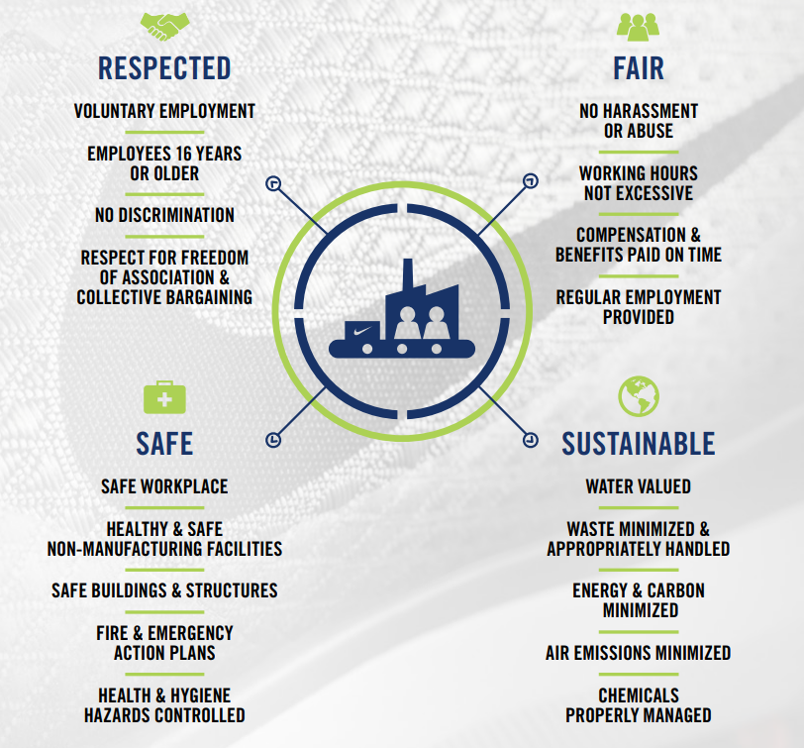
QUALITY MANAGEMENT
Code of Conduct
The Code of Conduct is an integral
component of Nike’s sourcing
strategy and is how it determines
the suppliers it will work with to
create a lean, green and equitable
supply chain.

Slide 9
COSTS AND EXPENDITURES
Nike actively uses the Internet(Nike Direct) to sell sportswear, sports shoes, and sports equipment, which reduces sales expenses and increases revenue.
Nike's strategic adjustments in Nike's operating costs and expenses have kept Nike's annual revenue growth. As strategic investments in innovation and digital drove global consumer demand led by NIKE Direct.
Compared to 2014, Nike’s net income increased by 22% while its operating expenses increased only by 16% in 2015.
Notes:
Based on Nike's strategic adjustments to Nike's operating costs and expenses, Nike's annual revenue has continued to grow. With strategic investment in innovation and digital technology, global consumer demand, led by NIKE Direct, has been driven. Nike's strategic adjustments keep Nike's annual revenue growth.

Slide 10
2019 INCOME STATEMENT REVIEW
Nike Direct
Revenue: $11.8 billion
16% increase
driven by 35% increase in digital commerce sales.
Sales to wholesale customers increased 10%, driven by double-digit growth in Asia and the digital business.
Converse
Revenue: $491 million
driven by growth in Asia and digital business
However, has offset by declines in US and Europe
NIKE’s selling and administrative expense increased 10 percent to $12.7 billion. Net income increased to $4.0 billion and diluted earnings per share was $2.49.
Notes:
2 Revenues for the NIKE Brand were $37.2 billion, NIKE Direct revenues were $11.8 billion, up 16 percent on a currency-neutral basis, driven by a 35 percent increase in digital commerce sales, 6 percent growth in comparable store sales as well as the addition of new stores. Sales to wholesale customers increased 10%.Driven by double-digit growth in Asia and the digital business, Converse's revenue was $ 491 million, but this was offset by declines in US and European business.
3 Selling and administrative expense increased 10 percent to $12.7 billion. Net income increased to $4.0 billion and diluted earnings per share was $2.49.

Slide 11
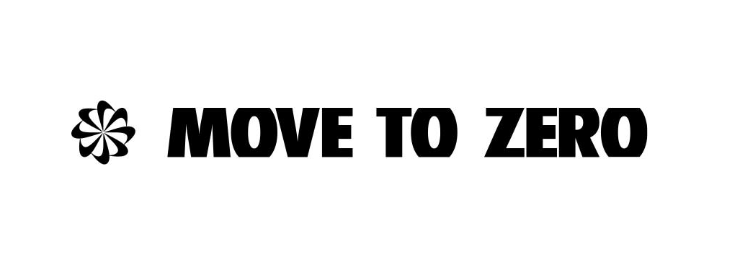
SOCIAL RESPONSIBILITY
MOVE TO ZERO
Nike will be power owned-and-operated facilities with 100 percent renewable energy by 2025.
Nike will reduce carbon emissions across its global supply chain by 30 percent by 2030, in line with the Paris Agreement of 2015.
Nike diverts 99 percent of all footwear manufacturing waste from landfills.
Additionally, Nike diverts more than 1 billion plastic bottles per year from landfills to create yarns for new jerseys and uppers for Flyknit shoes.
The Reuse-A-Shoe and Nike Grind programs convert waste into new products, playgrounds, running tracks and courts.

Slide 12
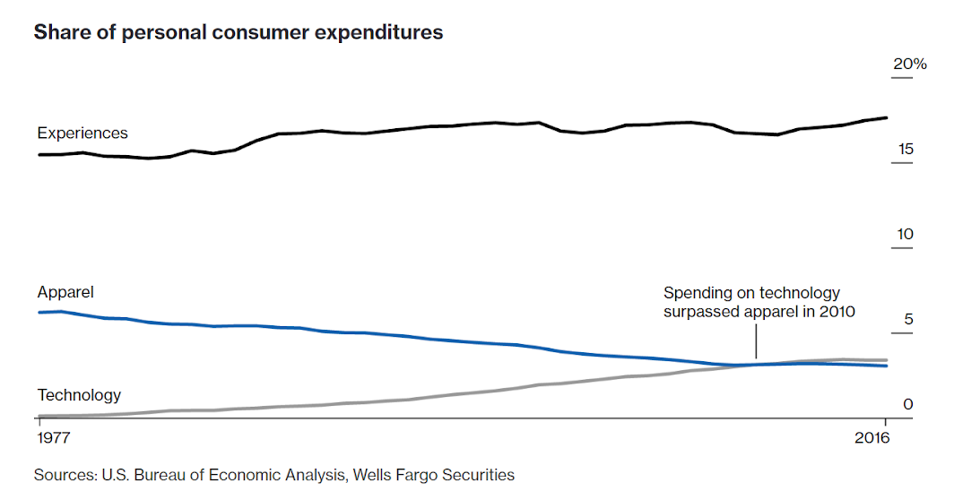
KEY CHALLENGES
Digitization of Supply Chain
Customization
Excess Inventory with Retail Partners
Industry Dynamic
Maintaining of Brand Recognition

Slide 13
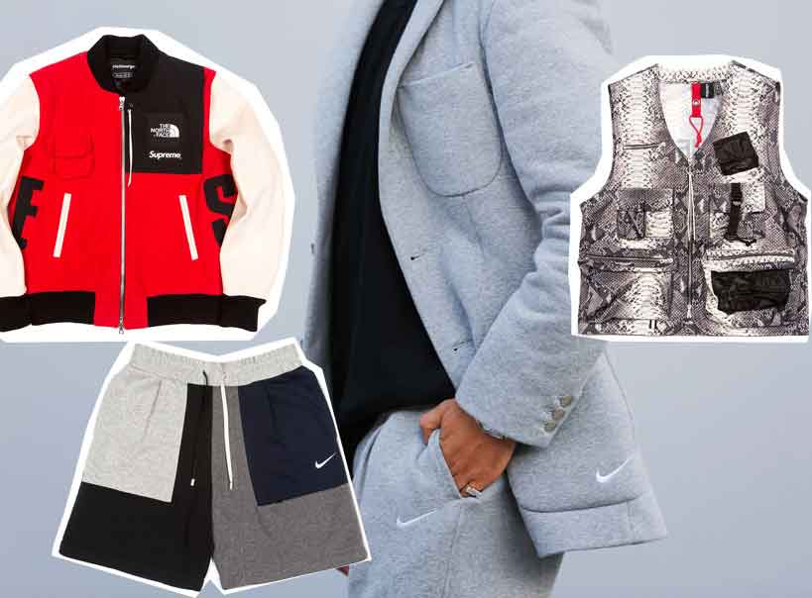
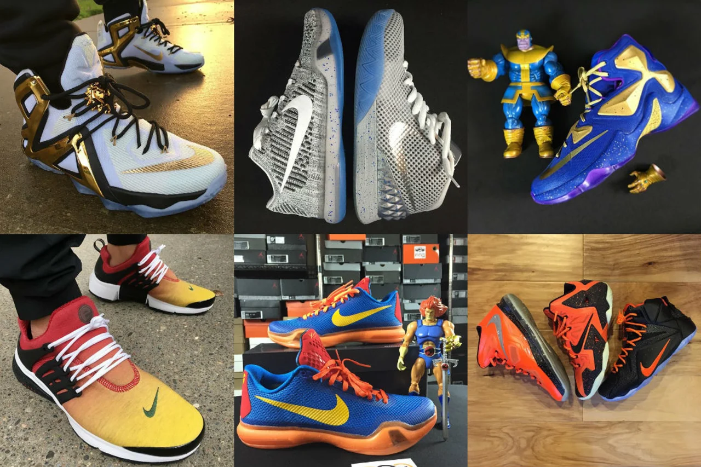
STRATEGIES
Customer Direct Offense
“Triple Double Strategy”
"2X Innovation, 2X Speed
and 2X Direct connections
with consumers.“
Nike ID
Notes:
Nike ID customization strategy in 2019 push to higher profits

Slide 14
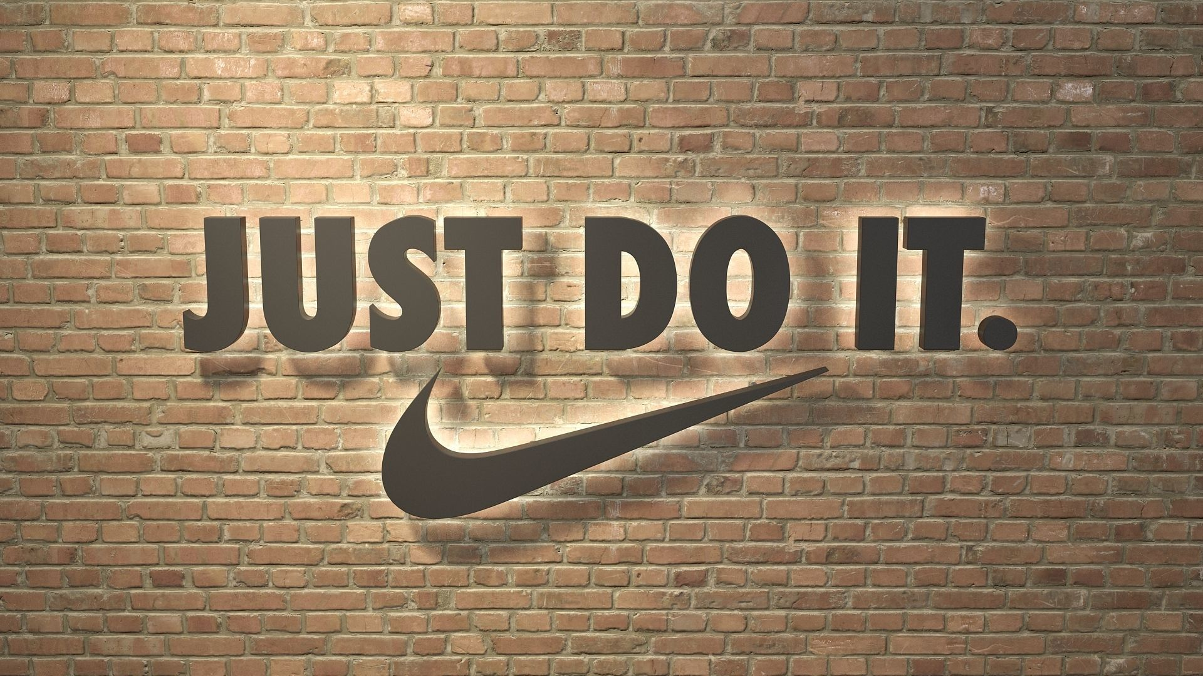

Slide 15
CITATIONS
“From Factory to Footwear: Inside the Nike Supply Chain.” Supplychainx, 4 Apr. 2018, https://supplychainx.highjump.com/nike-supply-chain.html
Carpenter, William. “Nike Stock: Analyzing 5 Key Supplier (NKE).” Investopedia, 2 Nov, 2019. https://www.investopedia.com/articles/markets/051416/nike-stock-analyzing-5-key-suppliers-nke.asp
Caudell, Dustin. “What Supply Chain Managers Can Learn from Nike and Apollo Global Partnership.” RFgen, 30 Sep. 2016, https://www.rfgen.com/blog/what-supply-chain-managers-can-learn-from-nike-and-apollo-global-partnership/
“NIKE, Inc. Announces New Consumer Direct Offense: A Faster Pipeline to Serve Consumers Personally, At Scale.” Nike News, 15 June 2017, https://news.nike.com/news/nike-consumer-direct-offense.
Rupp, Lindsey, et al. “The Death Of Clothing.” Bloomberg.com, Bloomberg, 5 Feb. 2018, https://www.bloomberg.com/graphics/2018-death-of-clothing/.
Anonymous. “Striding Forward: Nike's Quest to Reinvent Its Supply Chain.” Technology and Operations Management, 15 Nov. 2017, https://digital.hbs.edu/platform-rctom/submission/striding-forward-nikes-quest-to-reinvent-its-supply-chain/.
Anonymous. “Sourcing Standards.” Nike Purpose, 3 Dec. 2019. Web. https://purpose.nike.com/sourcing-manufacturing-standards.
How Nike Solved Its Sweatshop Problem. (2013, May 9). Businessinsider.com: https://www.businessinsider.com/how-nike-solved-its-sweatshop-problem-2013-5
Five Ways Nike Celebrates Earth Day Every Day. (2019, April 22). News.nike.com: https://news.nike.com/news/earth-day-sustainability-2019
Greenhouse, S. (1997, November 8). Nike Shoe Plant in Vietnam Is Called Unsafe for Workers. Nytimes.com:https://www.nytimes.com/1997/11/08/business/nike-shoe-plant-in-vietnam-is-called-unsafe-for-workers.html
“NIKE, Inc. Reports Fiscal 2019 Fourth Quarter and Full Year Results.” Nike.Com, 2019, investors.nike.com/investors/news-events-and-reports/investor-news/investor-news-details/2019/NIKE-Inc-Reports-Fiscal-2019-Fourth-Quarter-and-Full-Year-Results/default.aspx.
‌“Nike | NKE | Operating Expenses.” Tradingeconomics.Com, 2019, tradingeconomics.com/nke:us:operating-expenses. Accessed 6 Dec. 2019.
“NIKE, Inc. Reports Fiscal 2014 Fourth Quarter and Full Year Results.” Nike.Com, 2014, investors.nike.com/investors/news-events-and-reports/investor-news/investor-news-details/2014/NIKE-Inc-Reports-Fiscal-2014-Fourth-Quarter-and-Full-Year-Results/default.aspx. Accessed 6 Dec. 2019.

